Slide 1
Iris recognition
Term project initial report
Ieremias Viorel
Gr. 30442

Slide 2
Advantages of iris-based biometrics systems
the structure is fixed from about one year in age and remains constant over time
the variations in the gray level intensity values distinguish two individuals; the difference exists between identical twins and even between left and right eye of the same person
the features are not genetically determined
Accuracy proven to be much higher compared to other types of biometric systems like fingerprint, handprint and voiceprint

Slide 3
General structure
A typical iris recognition system involves four main modules:
Image acquisition - factors that determine the quality of the image include: illumination, position, physical capture system and number of pixels on the iris
Preprocessing: includes steps like iris liveness detection, pupil and iris boundary detection, eyelid detection and removal and normalization (iris liveness detection differentiates live subject from a photograph, a video playback, a glass eye or other artifacts)

Slide 4
General structure cont’d
Segmentation and unwrapping - isolate the iris region from the rest of the image and unwrap it into a rectangular area, according to rubber-sheet model
Feature extraction - most prominent features for classification are x-y coordinates, radius, shape and size of the pupil, intensity values, orientation of the pupil ellipse and ratio between average intensity of two pupils; the features are encoded to a format suitable for recognition
Recognition - achieves result by comparison of features with stored patterns; the interclass and intra-class variability are used as metrics for pattern classification problems

Slide 5
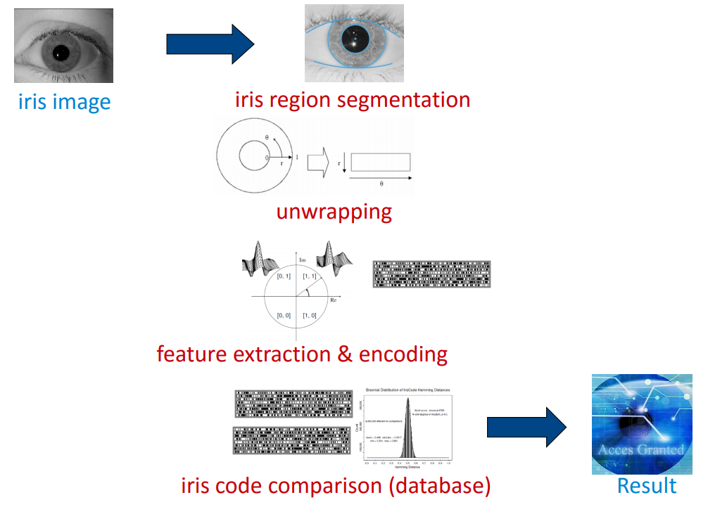

Slide 6
Iris recognition methods
Phase-based method - uses phase information, which is independent of imaging contrast and illumination
Texture-based analysis method - requires high quality image
Zero-crosssing representation method - the algorithm is translation, rotation and scale invariant, but the images that are compared need to have the same number of crossings at each resolution level
Notes:
generate cross-spectrum of the DFTs of the 2 images; a sharp peak of the POC (phase-only correlation) function indicates high correlation
applies Haar transform to image to obtain iris codes and match them using Hamming distance
select two independent iris sectors, each of 90 in width; much higher correlation of the iris body in the radial direction as compared to the angular direction; applied a scaled Laplacian of Gaussians as a filtering function; compare the resulting f-stripes

Slide 7
Iris recognition methods cont'd
Approach based on intensity variations - the sharp variation points of iris patterns are recorded as features
Approach using Independent Component Analysis
Iris authentication based on Continuous Dynamic Programming - authenticates iris based on kinematic characteristics, acceleration; works on the concept of comparing shape characteristics part wise

Slide 8

Proposed solution
Image acquisition
use CASIA v.1 dataset of images
each image has size 320x280 pixels and is take in near infrared spectrum
Segmentation and unwrapping
find pupil boundary and iris boundary using Daugman Integro-Differential operator
allow an amount of shift between pupil center and iris center, to account for cases when the 2 are not concentric

Slide 9

Proposed solution cont’d
reduce search space by integrating heuristics about pupil and iris size (max expected pupil radius, iris radius in whole image, etc.)
unwrap image into a cartesian rectangular representation and resize to 512x64 pixels; angular dimension is translated along the longer 512 pixels axis, while the polar dimension is translated on the 64 pixels axis
apply histogram equalization to enhance image features
Feature extraction
subdivide image into 8 blocks, each 64x64 pixels in size

Slide 10

Proposed solution cont’d
apply a multichannel Gabor filters approach
define a bank of 24 2D Gabor filters by varying 2 parameters: kernel size and filter orientation
apply the bank of filters on each of 8 blocks => 8 * 24 = 192 applications
for each block and each filter, calculate average absolute deviation (AAD)
And append the result to the iris code

Slide 11
Proposed solution cont’d
Matching
compute iris codes for 2 images
apply Eucliadian distance on the 2 vectors of real numbers
threshold the value to obtain classification result

Slide 12
Challenges
segmentation that accounts for non-concentric pupil and iris
removal of noisy zones introduced by eyelids and eyelashes
definition of the parameters for the set of Gabor wavelets
definition of the metric for the matching component

Slide 13
References
Iris Recognition Methods - Survey - S. V. Sheela, P. A. Vijaya
A Phase-Based Iris Recognition Algorithm - Kazuyuki Miyazawa, Koichi Ito, Takafumi Aoki, Koji Kobayashi and Hiroshi Nakajima
Iris recognition with compact zero-crossing-based coding - Adam Czajka and Przemek Strzelczyk
IRIS recognition - Eduard Bakštein
Iris Recognition Based on Multichannel Gabor Filtering - Li Ma, Yunhong Wang, Tieniu Tan

